Slide 1

Computational Social Science
Yunji Liang
2021-3-22

Slide 2


Instructors
►Associate Professor
►School of Computer Science
►Email: liangyunji@nwpu.edu.cn
►Reseach Interests:
Internet of Things,
Natural Language Processing,
Pervasive Computing
► Office No. 509 @ CS building

Slide 3
Class Logistics
►Monday & Wensday, 19:00-19:50 & 20:00-20:50
►Start on the 22nd of March
►From 4th week to 9th week
►Online course via Tencent Meeting

Slide 4
Evaluation
There will be no exam in this course. Grading is done entirely through reports on various tasks throughout the course.
► You are expected to hand in 2 reports (proposals)
► Count for 50% of the final grade
► Two representations about your projects
► Count for 50% of the final grade

Slide 5
Contents
1. Complex Network and Social Network Analysis
► Lectures 1-6
► Includes: small-world, degree distribution, finding communities, and other advanced metrics, random growth, preferential attachment, and other growth models
2. Natural Language Processing
►Lectures 8-12
►Includes: language model, text classification, and sentiment analysis, data mining

Slide 6
Computational Social Science
Social sciences are a group of academic disciplines dedicated to examining society. This branch of science studies how people interact with each other, behave, develop as a culture, and influence the world.
Social science is, in its broadest sense, the study of society and the manner in which people behave and influence the world around us.
Social science tells us about the world beyond our immediate experience, and can help explain how our own society works - from the causes of unemployment or what helps economic growth, to how and why people vote, or what makes people happy. It provides vital information for governments and policymakers, local authorities, non-governmental organisations and others.

Slide 7
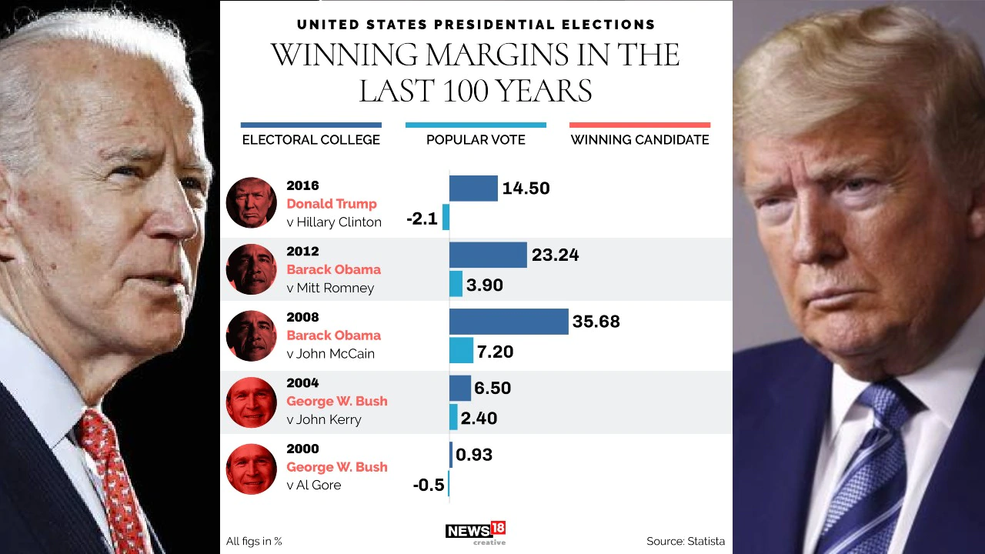
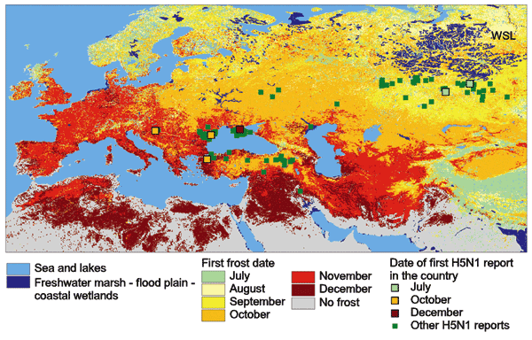
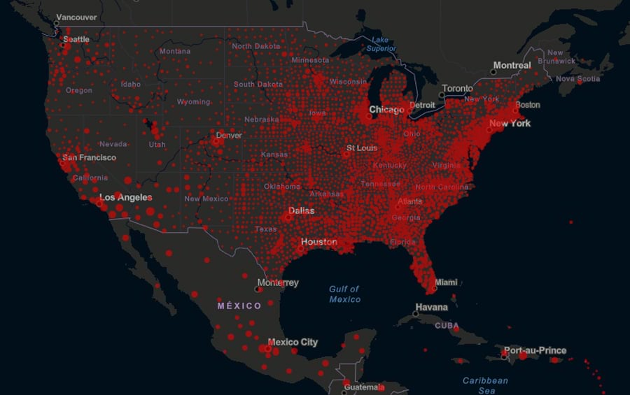
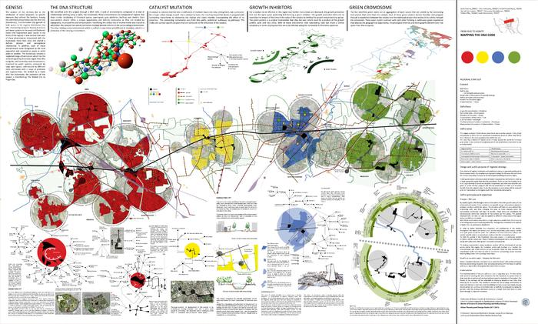
Computational Social Science

Slide 8
Computational Social Science
Data
Methodology
Conclusions
How to collect data?
Notes:
What is your favoriate Chinese food?
What is your first impression about China?

Slide 9
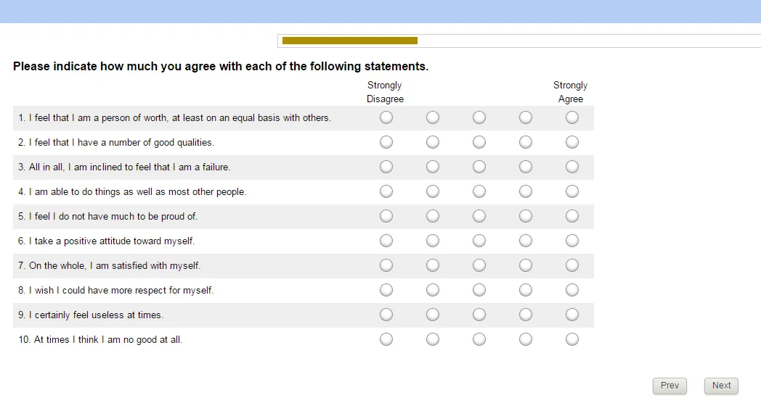
Computational Social Science
Data
Methodology
Conclusions
How to collect data?
►Questionnaire
►Phone Questionnaire
►Online Questionnaire

Slide 10
Computational Social Science
Data
Methodology
Conclusions
1. It is generally regarded as dependable when used to obtain statement of facts.
2. Information of a personal nature often may be obtained more readily by means of questionnaires.
3. It places less pressure on the subject for immediate response.
4. It helps in focusing the respondent’s attention on all the significant items. It does not permit much of variation.
5. It may be used as a preliminary tool for conducting indepth study later on by any other method.
6. The responses given by the subjects are available in their own language and version.

Slide 11
Computational Social Science
Data
Methodology
Conclusions
►Its reliability and validity is low. It seeks secondary information concerning facts when primary evidence is not at hand.
►It gives a biased sample. The matter of non-response is always a big question mark.
►The respondents who return the questionnaires may not constitute a representative section of the entire group.
►If the subject misinterprets a question or gives an incomplete or indefinite response, nothing can be done.
►Some respondents may not like to put their views on controversial issues in writing.
►The behaviours, gestures, reactions, emotions of the respondent remain unnoticed.
►Some of the research areas are so delicate, sensitive and confidential in nature that it becomes difficult to frame questions on them.

Slide 12
Computational Social Science
Data
Methodology
Conclusions
How to analysis the data?
►Statistical analysis
the science of collecting, exploring and presenting large amounts of data to discover underlying patterns and trends.
Notes:
What is your favoriate Chinese food?
What is your first impression about China?

Slide 13
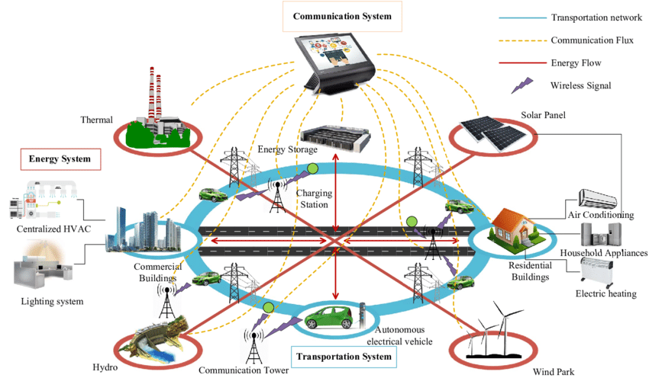
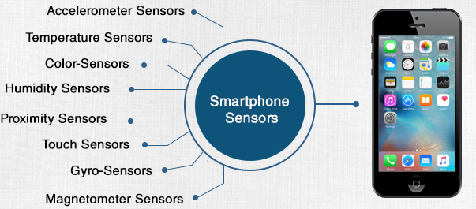

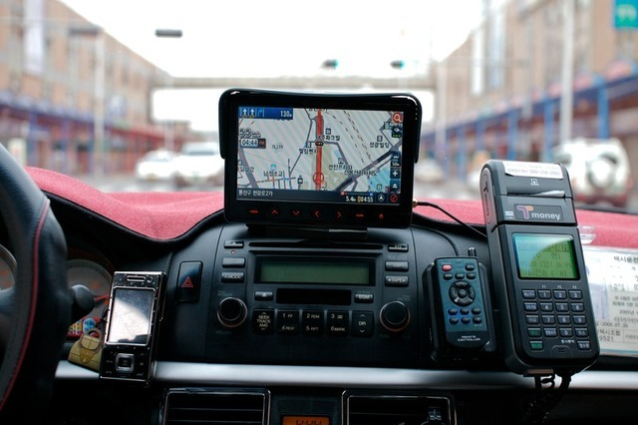
Computational Social Science
Why Computational Social Science?
Social Signals

Slide 14
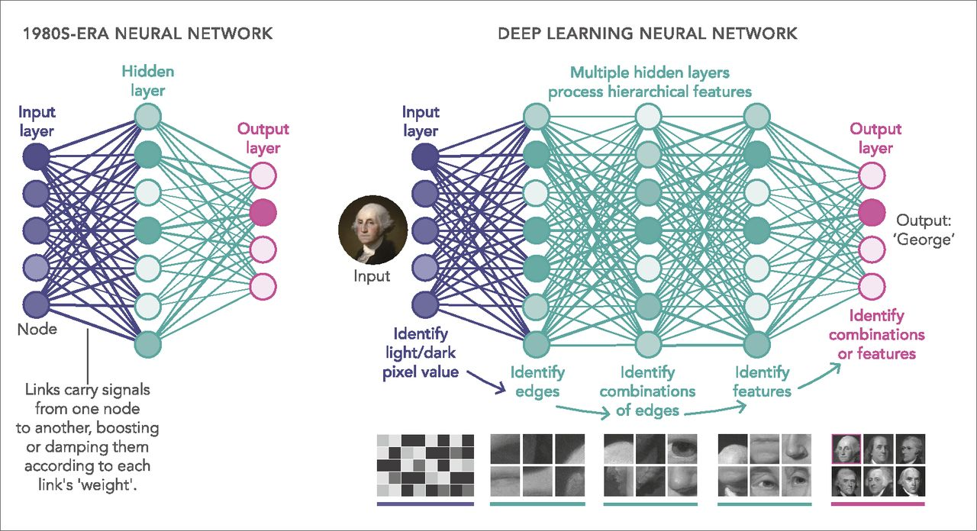
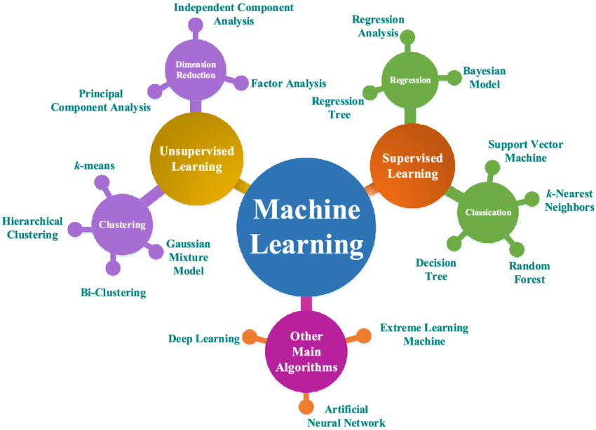
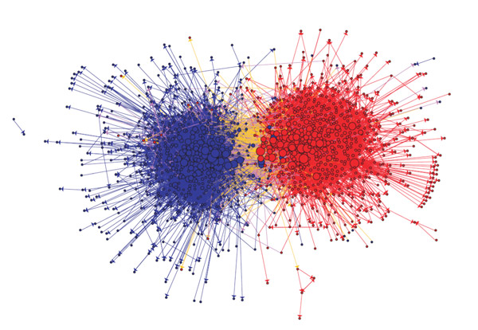
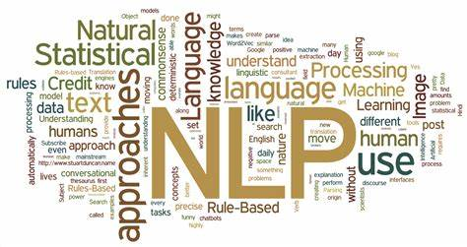
Computational Social Science
Why Computational Social Science?

Slide 15
Introduction
Complex Network and Social Network Analysis
Yunji Liang
2021-3-22

Slide 16
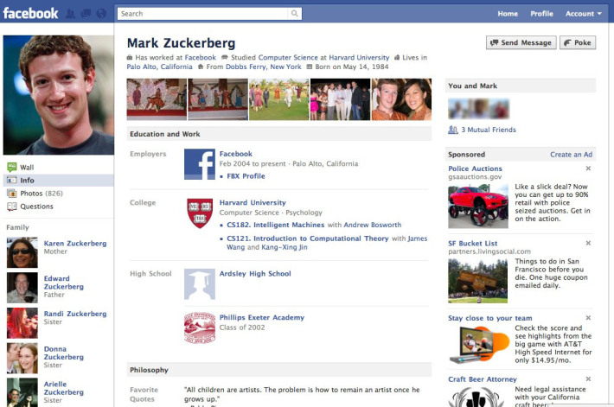
Facebook
How does Facebook use your data?
Where do you think Facebook can use your data?

Slide 17

Amazon

Slide 18

Yelp

Slide 19
Objectives of Our Course
Understand social aspects of the Web
Social Theories + Social media + Mining
Learn how to collect, clean, and represent social media data
How to measure important properties of social media and simulate social media models
Find and analyze communities in social media
Understanding friendships in social media, perform recommendations, and analyze behavior
Study or ask interesting research issues
e.g., start-up ideas
Learn representative algorithms and tools

Slide 20
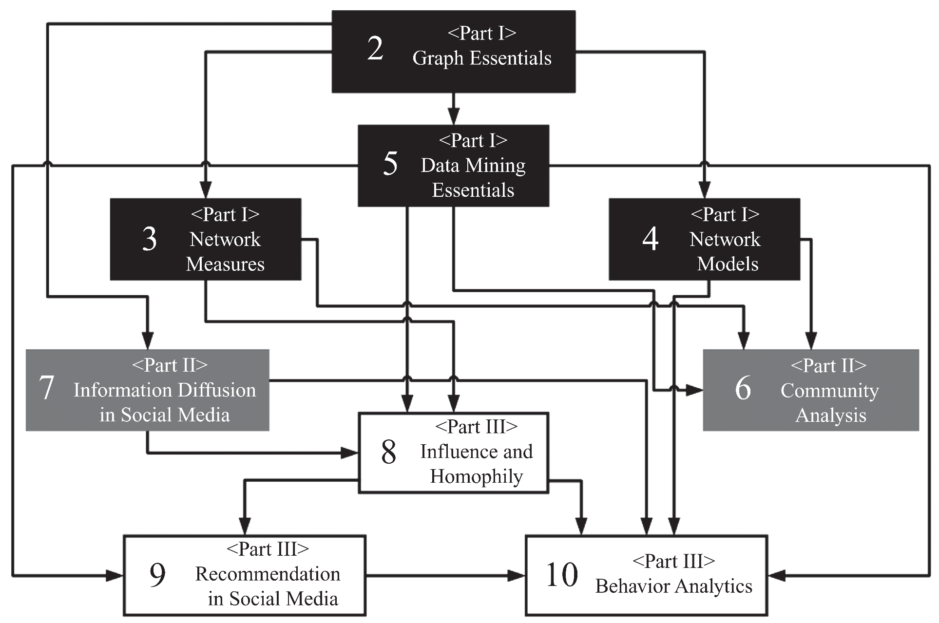
Overview – Dependency Graph

Slide 21
Social Media

Slide 22
Definition
Social Media is the use of electronic and Internet tools for the purpose of sharing and discussing information and experiences with other human beings in more efficient ways.

Slide 23
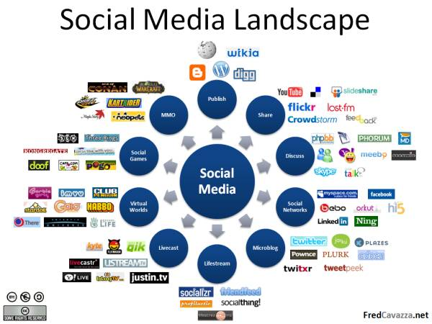
Notes:
Image Source: http://www.fredcavazza.net/2008/06/09/social-media-landscape/

Slide 24
Social Media Mining is the process of representing, analyzing, and extracting meaningful patterns from social media data

Slide 25
Social Media Mining Challenges
Big Data Paradox
Social media data is big, yet not evenly distributed.
Often little data is available for an individual
Obtaining Sufficient Samples
Are our samples reliable representatives of the full data?
Noise Removal Fallacy
Too much removal makes data more sparse
Noise definition is relative and complicated and is task-dependent
Evaluation Dilemma
When there is no ground truth, how can you evaluate?

Slide 26
Graph Essentials
Social Media Mining

Slide 27
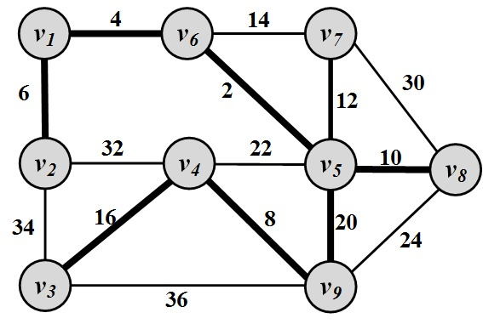
Networks
A network is a graph.
Elements of the network have meanings
Network problems can usually be represented in terms of graph theory
Twitter example:
Given a piece of information, a network of individuals, and the cost to propagate information among any connected pair, find the minimum cost to disseminate the information to all individuals.

Slide 28
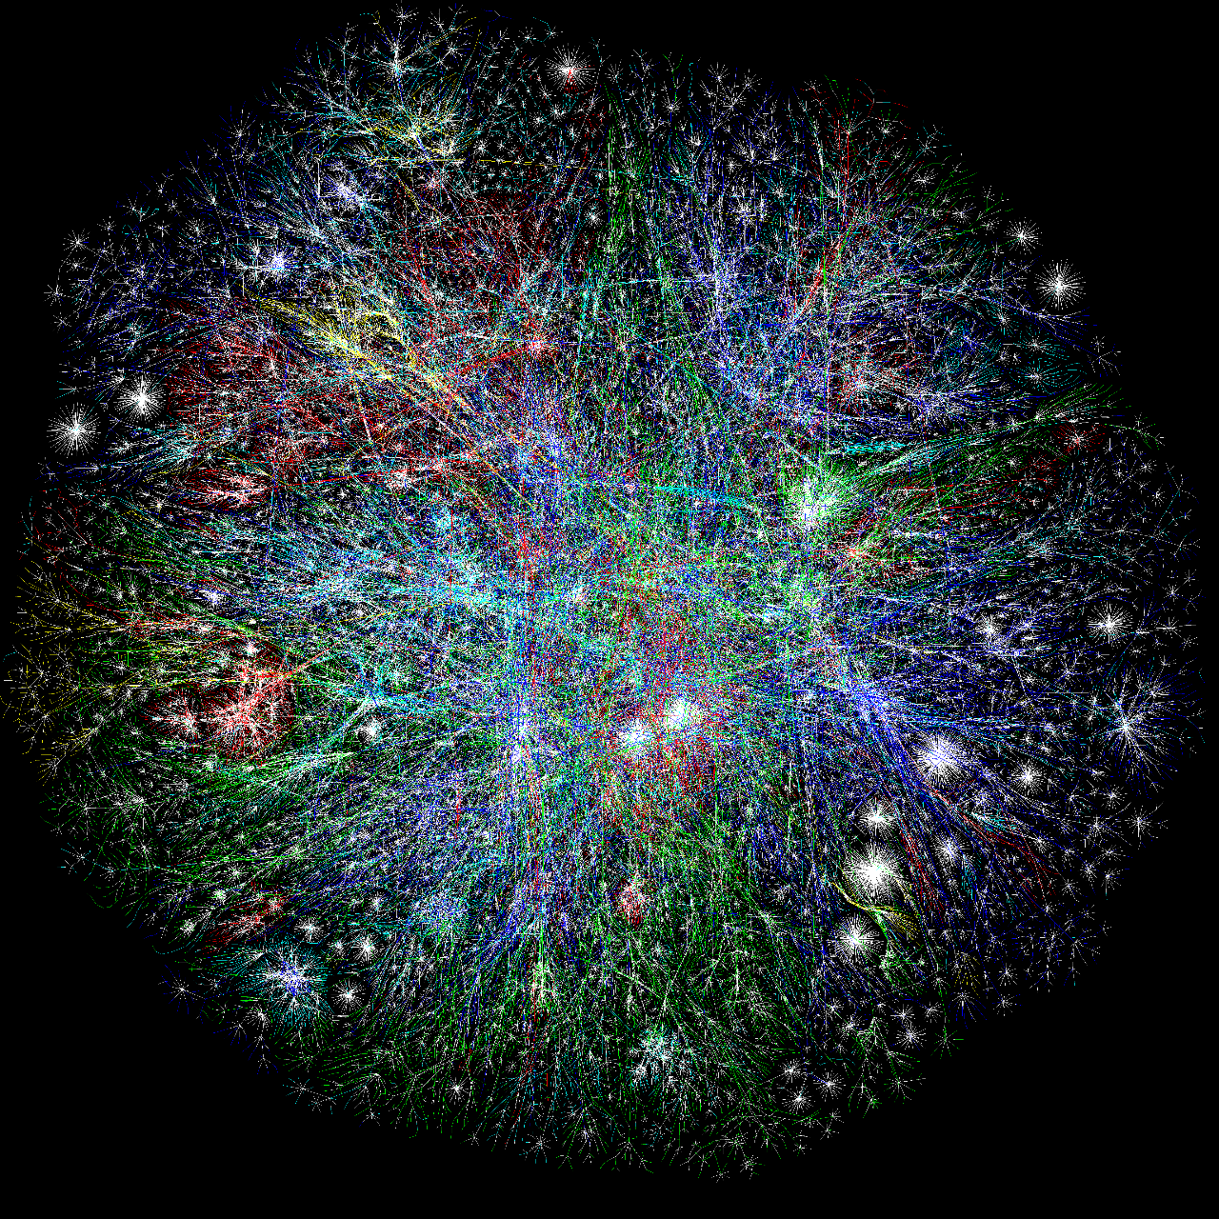
Internet

Slide 29
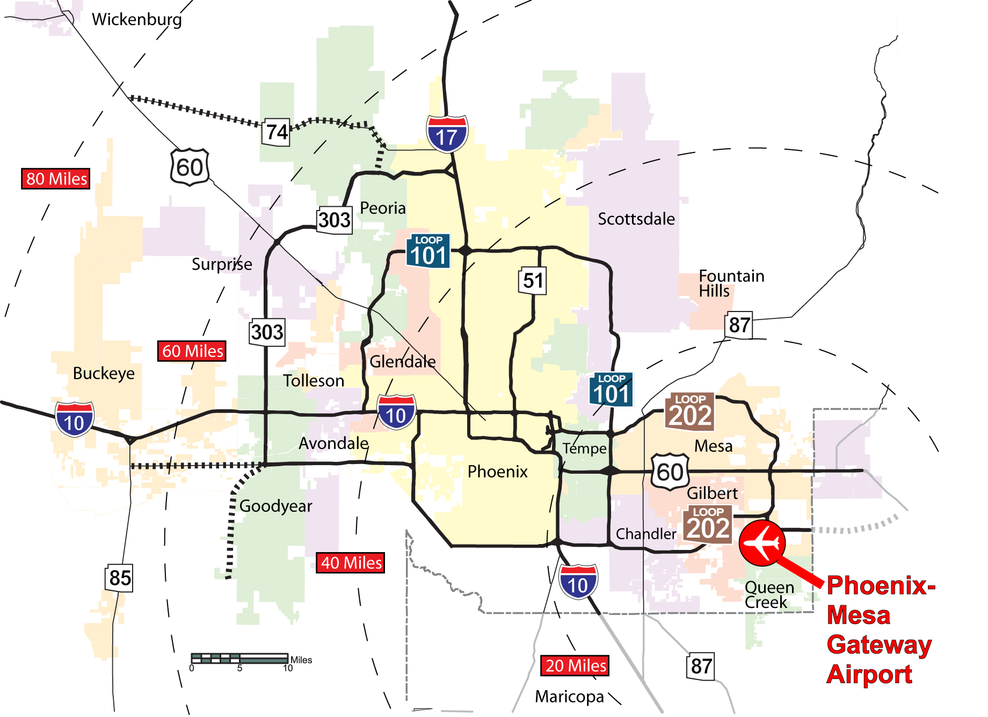
Phoenix Road Network
Notes:
http://www.autoblog.com/2011/12/21/new-art-reimagines-u-s-road-network-system-as-a-subway-map/

Slide 30
Social Networks and Social Network Analysis
A social network
A network where elements have a social structure
A set of actors (such as individuals or organizations)
A set of ties (connections between individuals)
Social networks examples:
your family network, your friend network, your colleagues ,etc.
To analyze these networks we can use Social Network Analysis (SNA)
Social Network Analysis is an interdisciplinary field from social sciences, statistics, graph theory, complex networks, and now computer science
Notes:
http://en.wikipedia.org/wiki/Social_network
Network science studies the laws and patterns of different networks in one context.

Slide 31
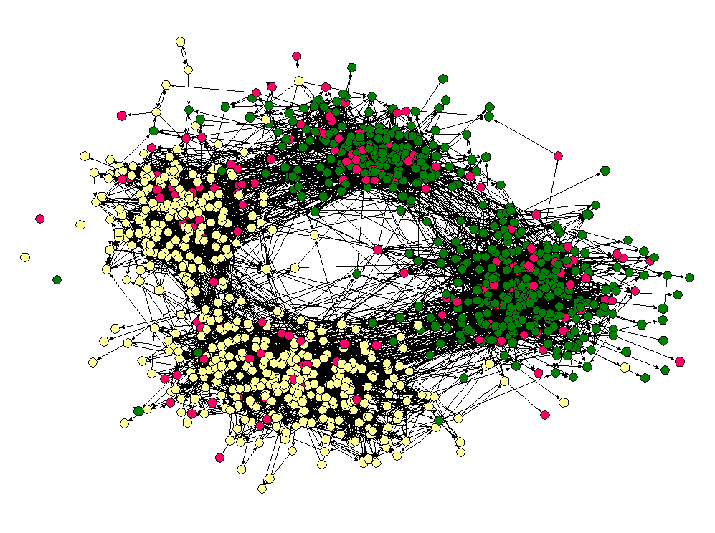
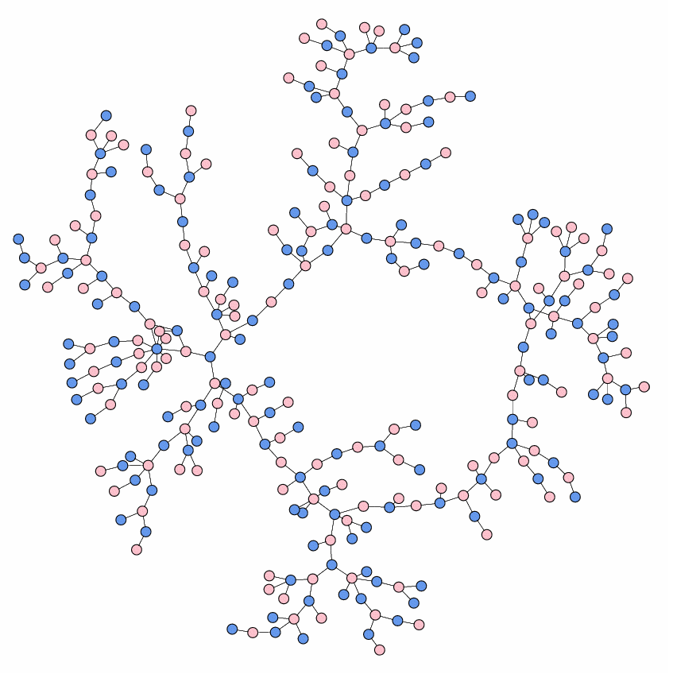
Social Networks: Examples
High school friendship
High school dating
Notes:
http://www-personal.umich.edu/~mejn/networks/
James Moody, Race, school integration, and friendship segregation in America, American Journal of Sociology 107, 679-716 (2001): Yellow = girls, Green = boys, Red = sexually active
High school dating: Data drawn from Peter S. Bearman, James Moody, and Katherine Stovel, Chains of affection: The structure of adolescent romantic and sexual networks, American Journal of Sociology 110, 44-91 (2004) image was made by M Newman

Slide 32
Graph Basics

Slide 33
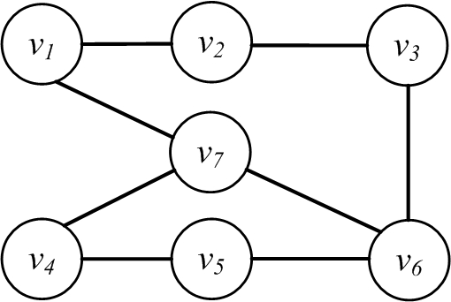
Nodes and Edges
A network is a graph, or a collection of points connected by lines
Points are referred to as nodes, actors, or vertices (plural of vertex)
Connections are referred to as edges or ties
Edge
Node

Slide 34
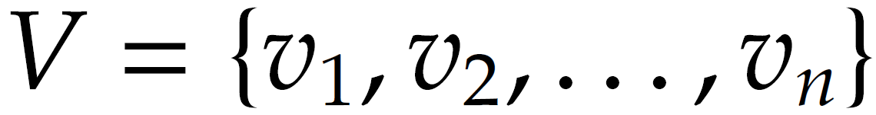
Nodes or Actors
In a friendship social graph, nodes are people and any pair of people connected denotes the friendship between them
Depending on the context, these nodes are called nodes, or actors
In a web graph, “nodes” represent sites and the connection between nodes indicates web-links between them
In a social setting, these nodes are called actors
The size of the graph is |V|= n

Slide 35
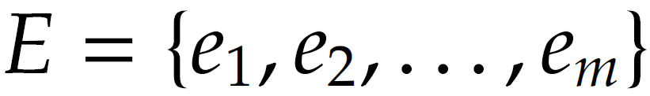
Edges
Edges connect nodes and are also known as ties or relationships
In a social setting, where nodes represent social entities such as people, edges indicate internode relationships and are therefore known as relationships or (social) ties
Number is edges (size of the edge-set) is denoted as |E|=m

Slide 36
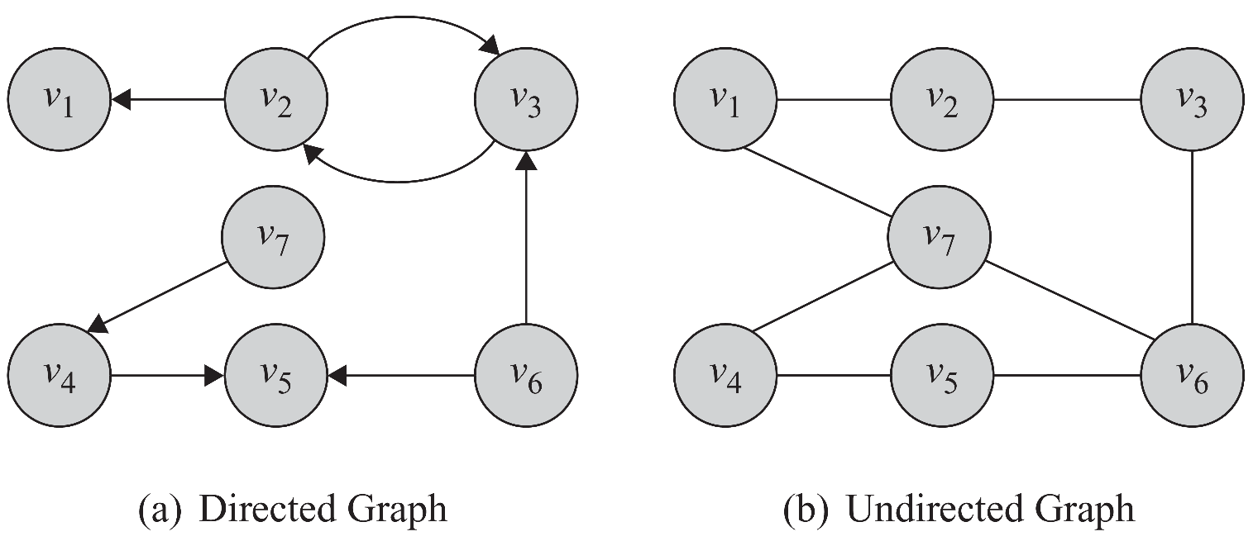
Directed Edges and Directed Graphs
Edges can have directions. A directed edge is sometimes called an arc
Edges are represented using their end-points e(v2,v1). In undirected graphs both representations are the same

Slide 37
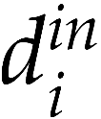
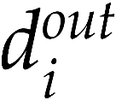
Neighborhood and Degree (In-degree, out-degree)
For any node v, the set of nodes it is connected to via an edge is called its neighborhood and is represented as N(v)
The number of edges connected to one node is the degree of that node (the size of its neighborhood)
Degree of a node i is usually presented using notation di
In case of directed graphs
In-degrees is the number of edges pointing towards a node
Out-degree is the number of edges pointing away from a node

Slide 38
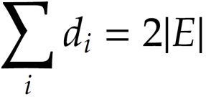
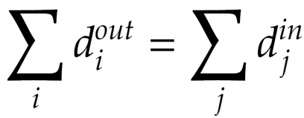
Degree and Degree Distribution
Theorem 1. The summation of degrees in an undirected graph is twice the number of edges
Lemma 1. The number of nodes with odd degree is even
Lemma 2. In any directed graph, the summation of in-degrees is equal to the summation of out-degrees,

Slide 39
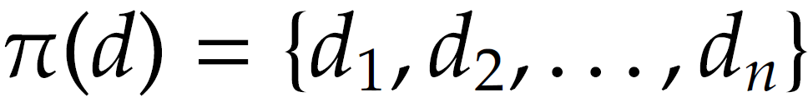
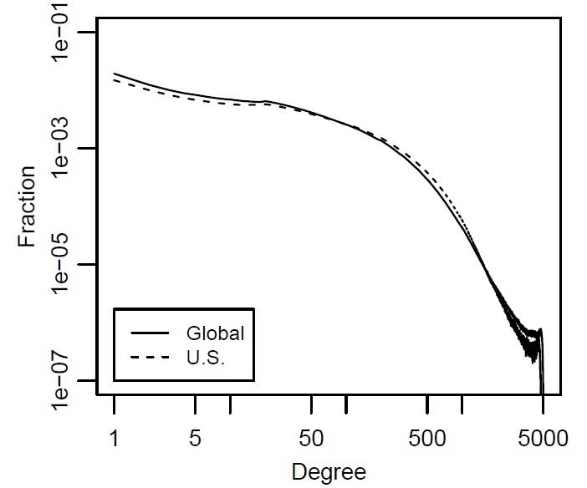
Degree Distribution
When dealing with very large graphs, how nodes’ degrees are distributed is an important concept to analyze and is called Degree Distribution
Where is the number of nodes with degree d
Degree distribution can be computed from degree sequence:
Degree distribution histogram
The x-axis represents the degree and the y-axis represents the number of nodes (frequency) having that degree

Slide 40
Subgraph
Graph G can be represented as a pair G(V; E), where V is the node set and E is the edge set
G’(V’,E’) is a subgraph of G(V,E)
6
4
5
5
1
3
1
3
2
2

Slide 41
Graph Representation
Adjacency Matrix
Adjacency List
Edge List

Slide 42
Graph Representation
Graph representation is straightforward and intuitive, but it cannot be effectively manipulated using mathematical and computational tools
We are seeking representations that can store these two sets in a way such that
Does not lose information
Can be manipulated easily by computers
Can have mathematical methods applied easily

Slide 43
Adjacency Matrix
1, if there is an edge between nodes vi and vj
0, otherwise
Diagonal Entries are self-links or loops
Social media networks have
very sparse Adjacency matrices

Slide 44
Adjacency List
In an adjacency list for every node, we maintain a list of all the nodes that it is connected to
The list is usually sorted based on the node order or other preferences

Slide 45
Edge List
In this representation, each element is an edge and is usually represented as (u, v), denoting that node u is connected to node v via an edge

Slide 46
Types of Graphs
Null, Empty, Directed/Undirected/Mixed, Simple/Multigraph, Weighted, Webgraph, Signed Graph

Slide 47
Null Graph and Empty Graph
A null graph is one where the node set is empty (there are no nodes)
Since there are no nodes, there are also no edges
G(V, E), V = E = ∅
An empty graph or edge-less graph is one where the edge set is empty, E = ∅
The node set can be non-empty.
A null-graph is an empty graph.

Slide 48
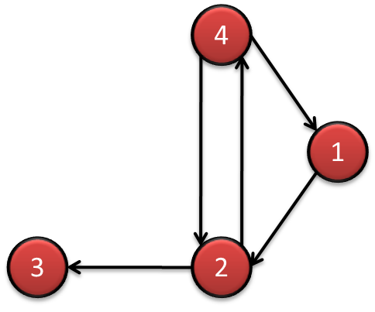
Directed/Undirected/Mixed Graphs
4
1
3
2
The adjacency matrix for directed graphs is not symmetric (A ≠ A^{T})
(A_{ij} ≠ A_{ji})
The adjacency matrix for undirected graphs is symmetric (A = A^{T})

Slide 49
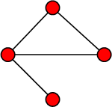
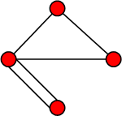
Simple Graphs and Multigraphs
Simple graphs are graphs where only a single edge can be between any pair of nodes
Multigraphs are graphs where you can have multiple edges between two nodes and loops
The adjacency matrix for multigraphs can include numbers larger than one, indicating multiple edges between nodes
Simple graph
Multigraph
Notes:
It is important for social network analysis as a pair can have more than one relations.

Slide 50
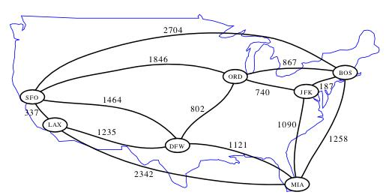
Weighted Graph
A weighted graph is one where edges are associated with weights
For example, a graph could represent a map where nodes are cities and edges are routes between them
The weight associated with each edge could represent the distance between these cities
G(V, E, W)
Notes:
Image: http://www.cs.ucr.edu/~neal/2004/cs141/?ShortestPathsByDijkstras

Slide 51
Webgraph
A webgraph is a way of representing how internet sites are connected on the web
In general, a web graph is a directed multigraph
Nodes represent sites and edges represent links between sites.
Two sites can have multiple links pointing to each other and can have loops (links pointing to themselves)

Slide 52
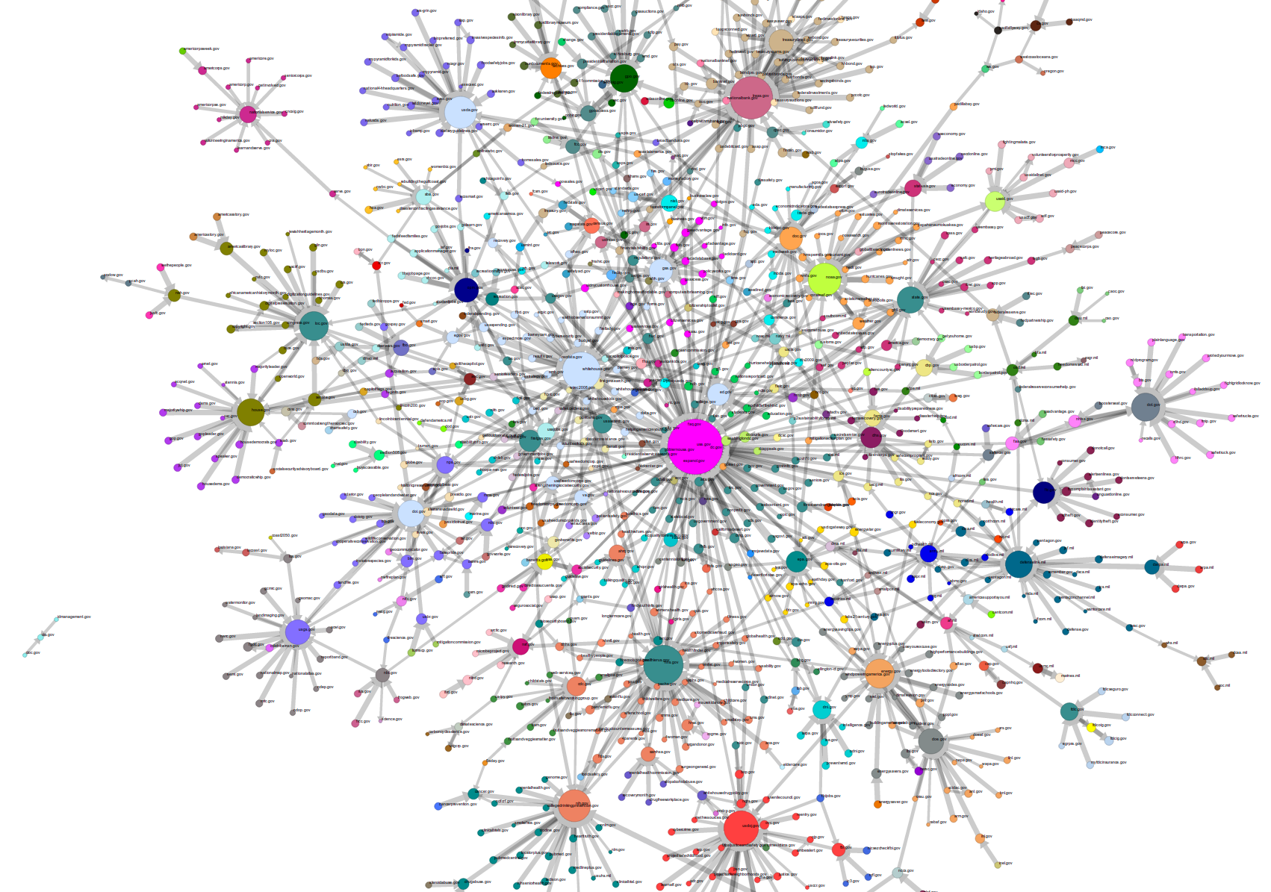
Webgraph: Government Agencies
Notes:
Image: http://research.library.unt.edu/eotcd/wiki/File:gov_20.png

Slide 53
Signed Graph
When weights are binary (0/1, -1/1, +/-) we have a signed graph
It is used to represent friends or foes
It is also used to represent social status

Slide 54
Quiz
Graph
Graph Representation
Degree
Degree Distribution

Slide 55
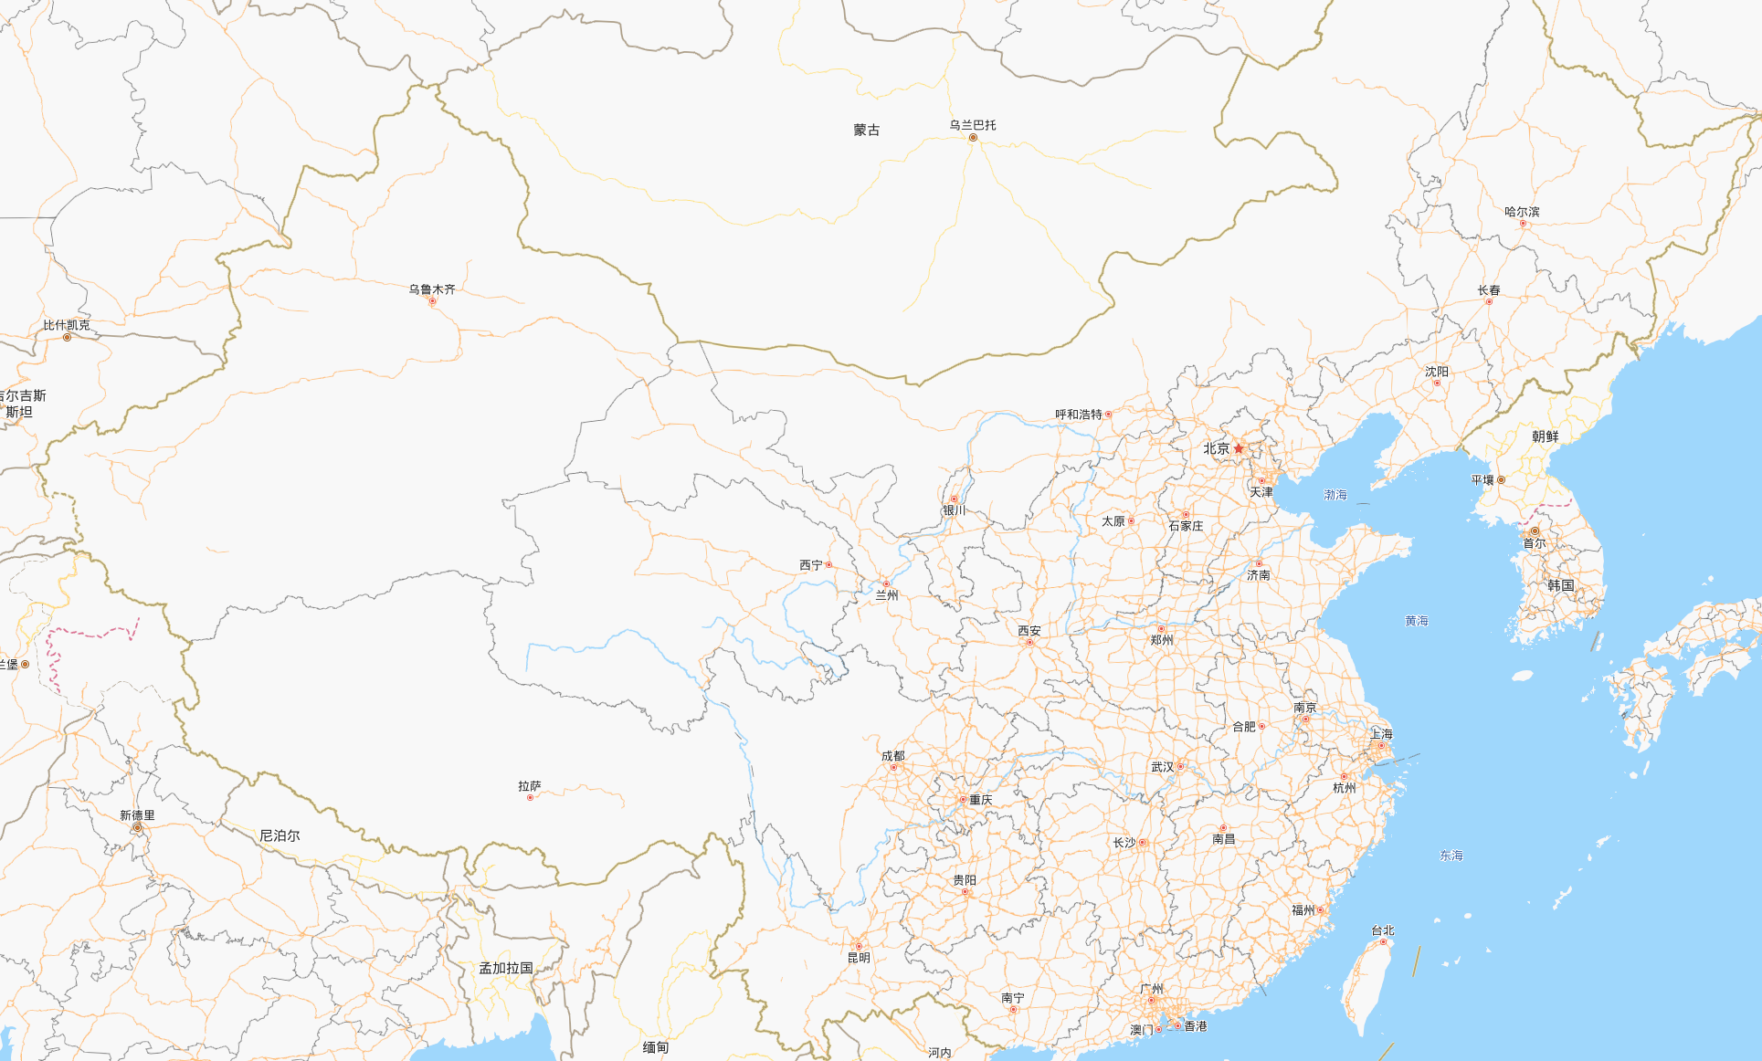
Quiz

Slide 56
Quiz
1
2
3
4
5
6
7
8
City | # of Nodes
Xi’an | 1
Beijing | 2
ZhengZhou | 3
Chengdu | 4
GuangZhou | 5
WuHan | 6
Shanghai | 7
XinJiang | 8
1
0 | 1 | 1 | 0 | 0 | 1 | 0 | 0
1 | 0 | 1 | 1 | 1 | 1 | 1 | 1
1 | 1 | 0 | 1 | 1 | 0 | 0 | 1
0 | 1 | 1 | 0 | 0 | 0 | 1 | 0
0 | 1 | 1 | 0 | 0 | 0 | 1 | 1
1 | 1 | 0 | 0 | 0 | 0 | 1 | 0
0 | 1 | 0 | 1 | 1 | 1 | 0 | 1
0 | 1 | 1 | 0 | 1 | 0 | 1 | 0
2
3
4
5
6
7
8

Slide 57
Quiz
1
2
3
4
5
6
7
8
1
0 | 1 | 1 | 0 | 0 | 1 | 0 | 0
1 | 0 | 1 | 1 | 1 | 1 | 1 | 1
1 | 1 | 0 | 1 | 1 | 0 | 0 | 1
0 | 1 | 1 | 0 | 0 | 0 | 1 | 0
0 | 1 | 1 | 0 | 0 | 0 | 1 | 1
1 | 1 | 0 | 0 | 0 | 0 | 1 | 0
0 | 1 | 0 | 1 | 1 | 1 | 0 | 1
0 | 1 | 1 | 0 | 1 | 0 | 1 | 0
City | # of Nodes | Degree
Xi’an | 1 | 3
Beijing | 2 | 7
ZhengZhou | 3 | 5
Chengdu | 4 | 3
GuangZhou | 5 | 3
WuHan | 6 | 4
Shanghai | 7 | 5
XinJiang | 8 | 4
2
3
4
5
6
7
8

Slide 58
Quiz
City | # of Nodes | Degree
Xi’an | 1 | 3
Beijing | 2 | 7
ZhengZhou | 3 | 5
Chengdu | 4 | 3
GuangZhou | 5 | 3
WuHan | 6 | 4
Shanghai | 7 | 5
XinJiang | 8 | 4
{3, 4, 5, 7}
{3, 2, 2, 1}
{3/8, 2/8, 2/8, 1/8}

Slide 59
Connectivity in Graphs
Adjacent nodes/Edges, Walk/Path/Trail/Tour/Cycle,

Slide 60
Adjacent nodes and Incident Edges
Two nodes are adjacent if they are connected via an edge.
Two edges are incident, if they share on end-point
When the graph is directed, edge directions must match for edges to be incident
An edge in a graph can be traversed when one starts
at one of its end-nodes, moves along the edge, and stops at its other end-node.

Slide 61
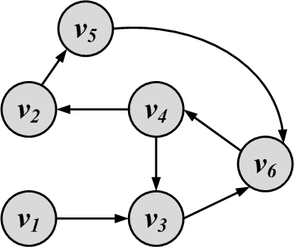
Walk, Path, Trail, Tour, and Cycle
Walk: A walk is a sequence of incident edges visited one after another
Open walk: A walk does not end where it starts
Close walk: A walk returns to where it starts
Representing a walk:
A sequence of edges: e₁, e₂, …, e_{n}
A sequence of nodes: v₁, v₂, …, v_{n}
Length of walk: the number of visited edges
Length of walk= 8

Slide 62
Trail
A trail is a walk where no edge is visited more than once and all walk edges are distinct
A closed trail (one that ends where it starts) is called a tour or circuit

Slide 63
Path
A walk where nodes and edges are distinct is called a path and a closed path is called a cycle
The length of a path or cycle is the number of edges visited in the path or cycle
Length of path= 4

Slide 64
Connectivity
A node v_{i} is connected to node v_{j} (or reachable from v_{j}) if it is adjacent to it or there exists a path from v_{i} to v_{j.}
A graph is connected, if there exists a path between any pair of nodes in it
In a directed graph, a graph is strongly connected if there exists a directed path between any pair of nodes
In a directed graph, a graph is weakly connected if there exists a path between any pair of nodes, without following the edge directions
A graph is disconnected, if it not connected.

Slide 65
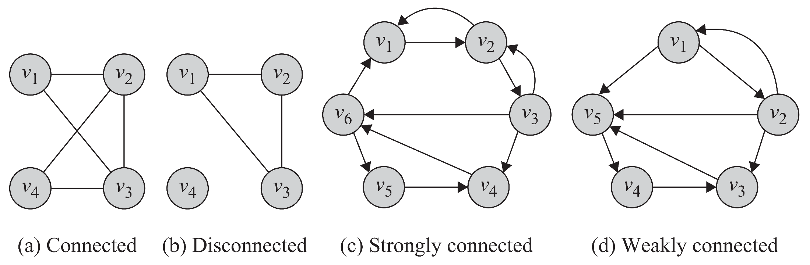
Connectivity: Example

Slide 66
Component
A component in an undirected graph is a connected subgraph, i.e., there is a path between every pair of nodes inside the component
In directed graphs, we have a strongly connected components when there is a path from u to v and one from v to u for every pair (u,v).
The component is weakly connected if replacing directed edges with undirected edges results in a connected component

Slide 67
Component Examples:
3 components
3 Strongly-connected
components

Slide 68
Shortest Path
Shortest Path is the path between two nodes that has the shortest length.
We denote the length of the shortest path between nodes v_{i} and v_{j} as
The concept of the neighborhood of a node can be generalized using shortest paths. An n-hop neighborhood of a node is the set of nodes that are within n hops distance from the node.

Slide 69
Diameter
The diameter of a graph is the length of the longest shortest path between any pair of nodes between any pairs of nodes in the graph
How big is the diameter of the web?

